Slide 1
ONLINE LEARNING APPLICATIONS
PROJECT PRESENTATION
Budget-Constrained Online Bidding
Learning to bid in first-price auctions under a shared budget — from a single stochastic campaign to non-stationary multi-campaign settings.
Team members: Arbizzani Tonelli Antonio, Arisi Leonardo, Berra Claudia, Di Paolo Gaia.
Requirements 1 – 4 · lab-aligned baselines and targeted extensions
July 2026

Slide 2



THE MODEL
Problem Setting
First-price auction, each round
Utility and cost on a win
Global budget constraint
m_{i,t} = highest competing bid for campaign i — the only uncertainty in the auction.
Higher bids win more often but earn less per win and spend more budget.
ρ is the per-round spend rate every learner has to respect on average.
Some campaigns are incompatible: connected campaigns cannot both bid in the same round. With multiple campaigns the action becomes a super-action: a feasible combination of bids, one for each campaign, selected at each round.
CONFLICT GRAPH
Across the four requirements:
1 → 4 campaigns
stochastic → non-stationary
semi-bandit → full feedback

Slide 3
HOW WE WORKED
Working Method
STEP 1
STEP 2
STEP 3
STEP 4
Lab-aligned baseline
Baseline Behavior
Targeted extension
Ablation
Course tools only — UCB, LP over distributions, Hedge, OGD — with the constants seen in the labs.
Read behaviour over time — regret, spend, chosen bids — and locate where the baseline is conservative.
Minimal change aimed at the observed defect. Out-of-course methods are explored and analyzed.
Same environment, same seeds, one change at a time — so every gain is attributed to its cause.
Every comparison is paired: baseline and improved learner run on the same realizations of the environment. Differences in the curves are differences between algorithms, not between random draws.

Slide 4
01
REQUIREMENT 1
Single Campaign, Stochastic Environment
Two required learners: budget-blind UCB1, and a UCB-like learner with the budget constraint handled by a linear program.
T = 5000
B = 125 → ρ = 0.025
v = 0.6
3 uniform competitors → P(win) = b³
discrete bid grid, b ≤ v
Stochastic clairvoyant: LP over bid distributions with true win probabilities, spend ≤ ρ. On this instance it mixes 96.6% on bid 0.4 — expected reward ≈ 0.0126 per round.
BENCHMARK

Slide 5
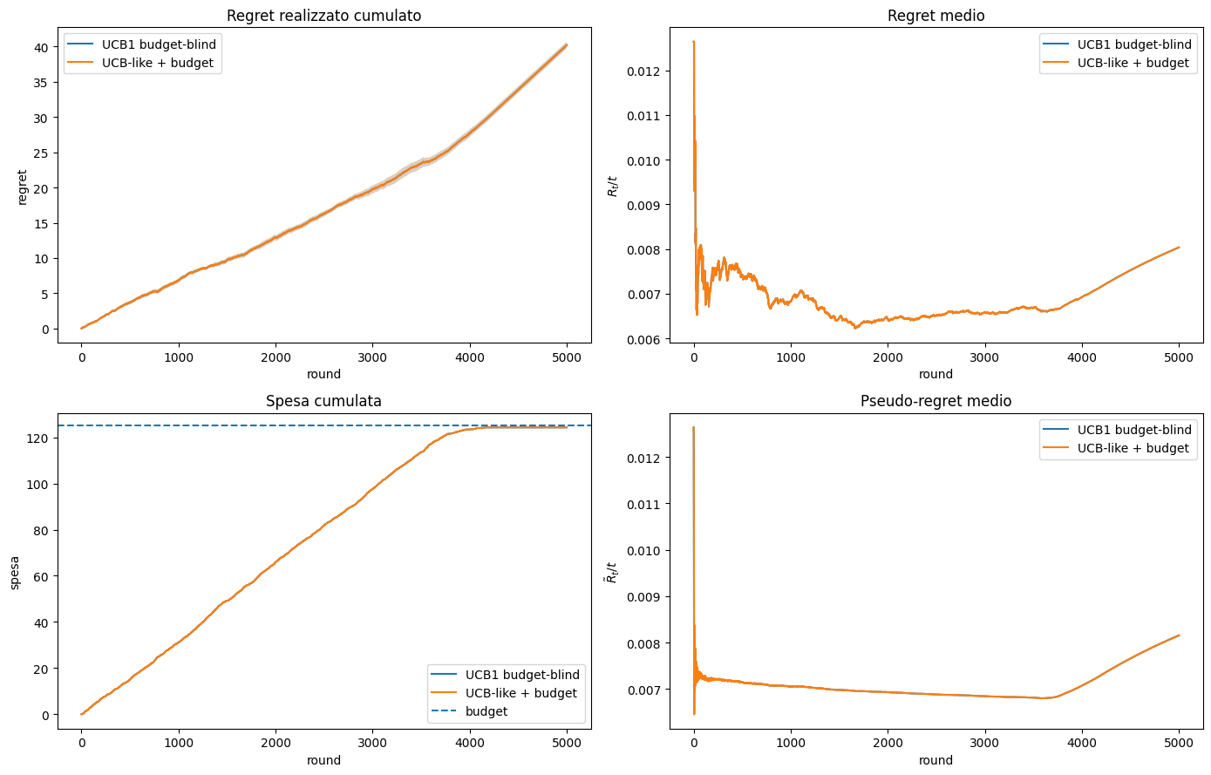
REQUIREMENT 1 · LAB-ALIGNED
Baseline: the Two Learners Are Nearly Identical
40.2
39.6
final regret, UCB1 budget-blind
final regret, UCB-like + budget LP
Why they coincide?
Hoeffding intervals stay wide over the whole horizon; the cost LCB is truncated at 0, so the LP constraint is almost never informative.
Both exhaust the budget early — the null bid is played in ≈ ⅓ of the rounds — and reach only ~36% of the clairvoyant reward.
The bottleneck is budget handling , not reward estimation.

Slide 6

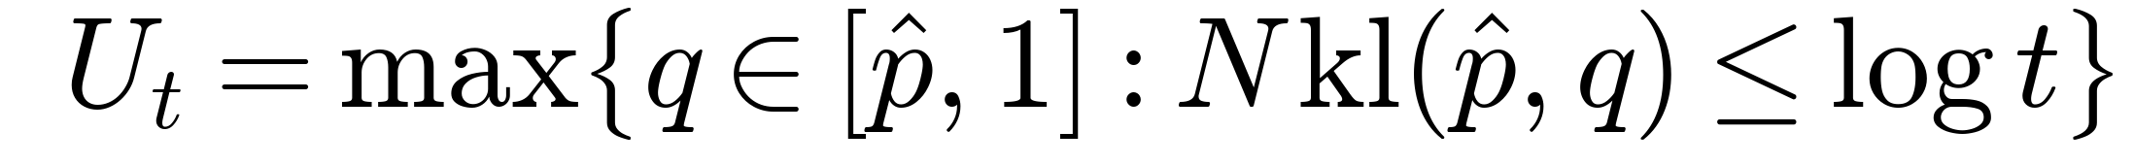

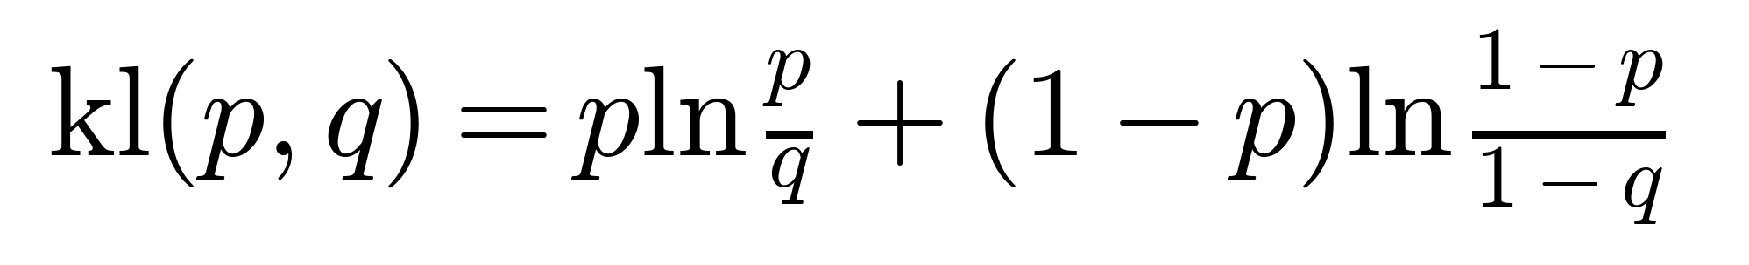
REQUIREMENT 1 · EXTENSION
Budgeted KL-UCB — Three Changes to the Learner
1 · ONE ESTIMATE: WIN PROBABILITY
2 · KL CONFIDENCE BOUND
3 · AFFORDABILITY FILTER
At a fixed bid, reward and cost are both driven by the win/loss outcome. We estimate the win probability directly and derive both from it.
Replaces Hoeffding’s p̂ + √(log t / 2N) with a KL-based bound, introduced to get tighter confidence estimates.
A bid enters the LP only if the remaining budget covers it; bid 0 stays as the zero-cost opt-out.
KL is a Bernoulli-specific distance between two win rates. It gives tighter bounds near 0 and 1, where Hoeffding tends to be too conservative.
THE kl(·,·) FUNCTION
Relevant win probabilities are tiny — P(win) = b³ is 0.027 at b = 0.3, 0.064 at b = 0.4. Near 0, Hoeffding’s radius √(log t / 2N) is far wider than needed: every p _{UCB} saturates at 1 and the optimistic reward (v−b)·p_{UCB} ranks bids backwards . The KL interval exploits the Bernoulli variance vanishing near 0 and tightens exactly where it matters.
WHY KL, HERE
Unchanged:
same LP, ρ = B/T fixed
same environment & seeds
dynamic pacing tried → no effect here, removed

Slide 7
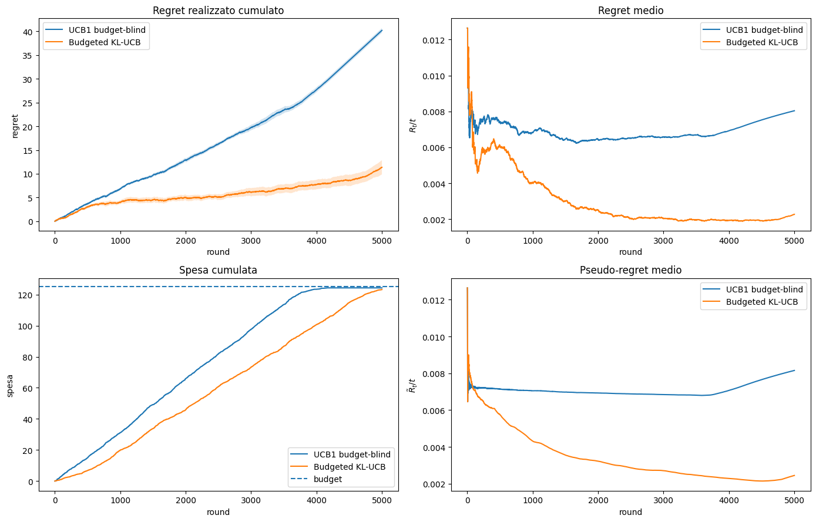
REQUIREMENT 1 · RESULTS
Results and Ablation
40.2
11.4
→
final regret
82%
123 / 125
of clairvoyant reward (was 36%)
budget spent, paced to the horizon
ABLATION — SAME SEEDS, ONLY THE BOUND CHANGES
KL 11.4 (spend 123/125) vs Hoeffding 35.7 (spend 45/125): Hoeffding keeps insisting on low bids, rarely wins, and cannot even spend the budget. The gain comes from the bound.

Slide 8
02
REQUIREMENT 2
Multiple Campaigns, Combinatorial-UCB with Budget
One super-action per round — a feasible bid profile over the conflict graph — with semi-bandit feedback and a shared budget.
4 campaigns · v = (0.95, 0.85, 0.78, 0.90)
T = 3000 · B = 700 → ρ ≈ 0.233
conflict chain 0–1–2–3
33 atomic arms · 250 super-actions
Beta marginals + 30% common factor → corr ≈ 0.3
BENCHMARK
Clairvoyant LP over feasible super-actions with true expected reward and cost, under the average budget rate rho = B/T.

Slide 9
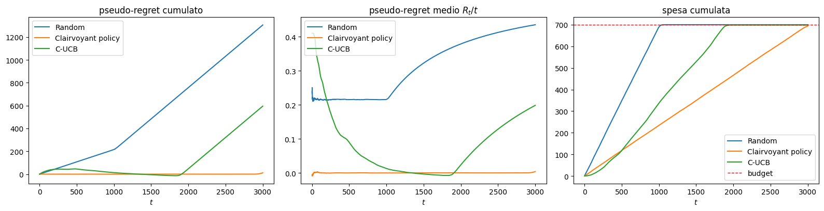
REQUIREMENT 2 · LAB-ALIGNED
Baseline: Learning Works, Pacing Fails
MID-HORIZON
t ≈ 1900
FINAL
Pseudo-regret ≈ 0 — indistinguishable from the clairvoyant policy: estimation is fine.
Cost LCB underestimates true spend → budget exhausted early → only the null action remains, regret restarts linear.
Pseudo-regret ≈ 595 (0.198/round) vs random 0.435/round. Budget never violated (max 699/700).

Slide 10


REQUIREMENT 2 · EXTENSION
Four Targeted Changes to the Learner
1 · p(win) PER ARM
2 · KL BOUND ON p(win)
One Bernoulli estimate per (campaign, bid) — semi-bandit feedback makes it valid arm by arm.
Same motivation as R1: many arms have small win probabilities where Hoeffding remains too loose and ranks arms less accurately.
3 · EMPIRICAL COST IN THE LP
4 · DYNAMIC PACING
A declared deviation from optimism: the LP gets an unbiased spend estimate. Defended by ablation →
The LP cap tracks the remaining budget, restricted to still-affordable super-actions and corrects early spend drift.
Same LP structure as the course baseline; only the inputs change.

Slide 11
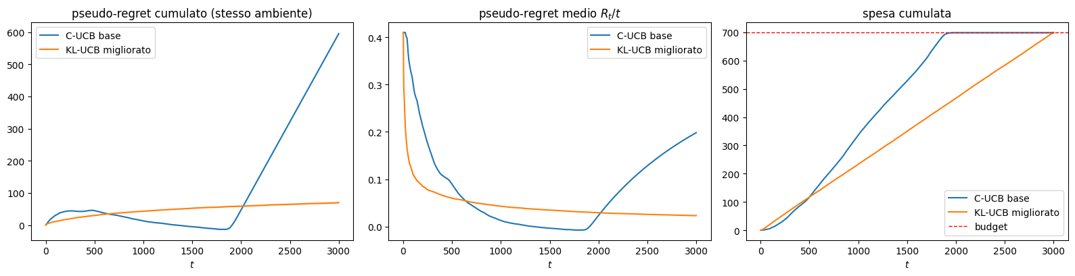
REQUIREMENT 2 · RESULTS
Results: Regret Stays Flat, Spend Reaches the Horizon
≈ 595
96%
0.023
→
≈ 70
final pseudo-regret, same seeds
of the oracle’s expected reward
R_{t}/t at the horizon — still decreasing

Slide 12
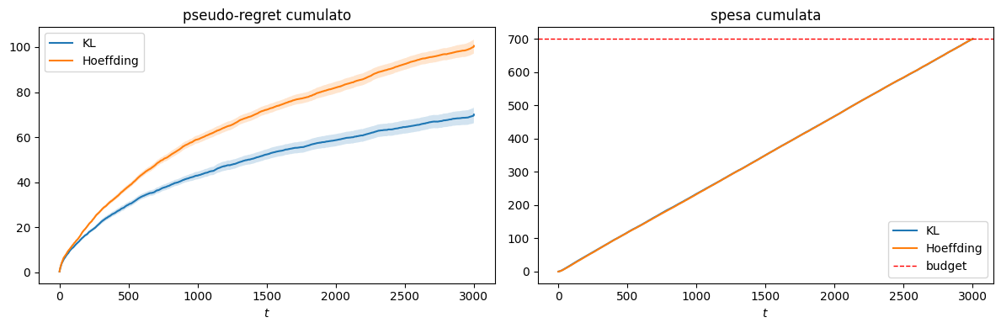
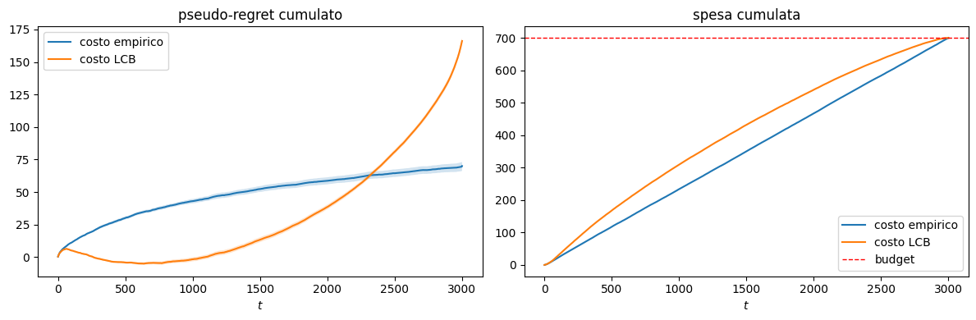
REQUIREMENT 2 · ABLATIONS
Ablations: Confidence Bound and Cost Estimate
70 vs 100
KL vs Hoeffding — only the bound changes; KL orders small-probability arms correctly.
70 vs 166
Empirical vs LCB cost — LCB spends 241 vs 176 by T/4; the early advantage collapses at the end.

Slide 13
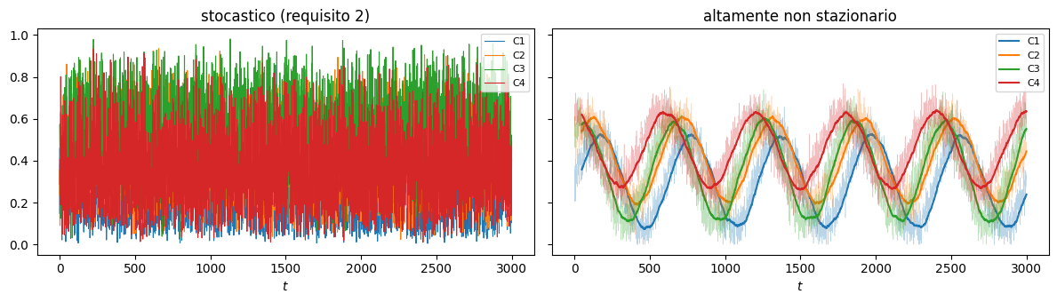
03
REQUIREMENT 3
Best-of-Both-Worlds: the Primal-Dual Method
Same instance as Requirement 2, now with full feedback — after each round, thresholds reveal reward and cost of every super-action.
Stochastic: Beta marginals + common factor
Highly non-stationary: oblivious fast sinusoids + small noise
T = 3000 · B = 700 · 250 super-actions
Hard budget enforcement
Best fixed distribution in hindsight satisfying the budget in expectation — we plot against full OPT, stricter than the ρ·OPT of the adversarial guarantee.
BENCHMARK

Slide 14
REQUIREMENT 3 · LAB-ALIGNED
Baseline: Primal-Dual with Course Constants
PRIMAL — HEDGE ON 250 SUPER-ACTIONS
0.249 / 0.222
regret/T — stochastic / non-stationary (random: 0.436 / 0.391)
DUAL — PROJECTED OGD, λ ∈ [0, 1/ρ]
569 / 558
spend out of 700 — clear under-spending, no violations
COURSE LEARNING RATES
Result
Primal-dual beats random in both regimes and never violates the budget, but converges slowly and leaves unused budget. The worst-case stop cannot explain the under-spend (it leaves at most one round of cost): it comes from the wide normalization and the generic constants.
Normalization choice: Hedge needs losses in [0,1], but L_{t} contains a time-varying λ_{t}. Fixed worst-case bounds (λ_{max} = 1/ρ) keep one scale for the whole horizon — at the price of a range ≈ 11 , which divides Hedge’s effective rate by the same factor, making it more conservative.

Slide 15

REQUIREMENT 3 · EXTENSION
Theory-Prescribed Learning Rates, Per-Action Budget Check
1 · RATES FROM THE THEORY
2 · PER-ACTION BUDGET CHECK
Replaces the global worst-case stop: only the sampled action that cannot be paid is substituted. Controls the action we actually execute instead of the worst case.
Hedge updates only on the action-dependent part of the Lagrangian (λ_{t} ρ is constant over actions) and uses the same fixed normalization. Not a new method — uses constants prescribed by Hedge and OGD theory for these specific ranges.
Declared asymmetry: Hedge and the dual still update on the proposed x _{t} , while the budget decreases with the cost of the executed action.
Override frequency is ≈ 0 in both regimes.
In the primal-dual, dynamic pacing is already encoded in the dual variable: λ_{t} rises when average spend exceeds ρ and depresses costly bids.
NO DYNAMIC PACING HERE
Ablation Study: The ablation study yields identical regret and expenditure for both rules, proving that performance gains stem entirely from optimal Hedge/OGD learning rates; however, the per-action constraint is preserved for its logical superiority in managing actual sampled actions over conservative worst-case shutdowns.

Slide 16
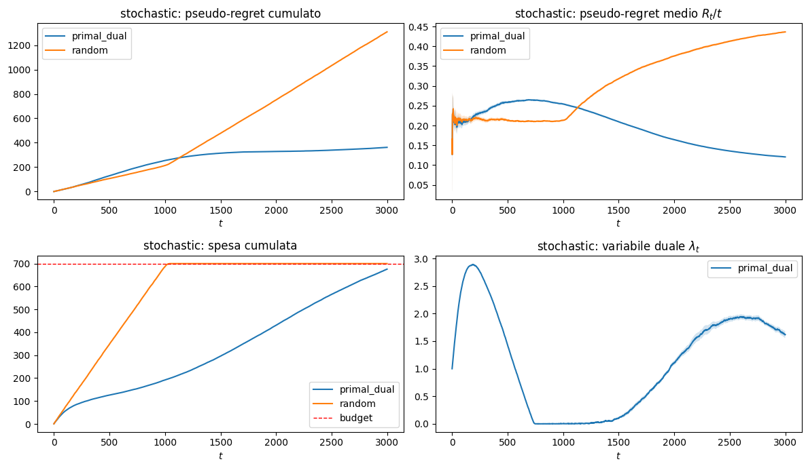
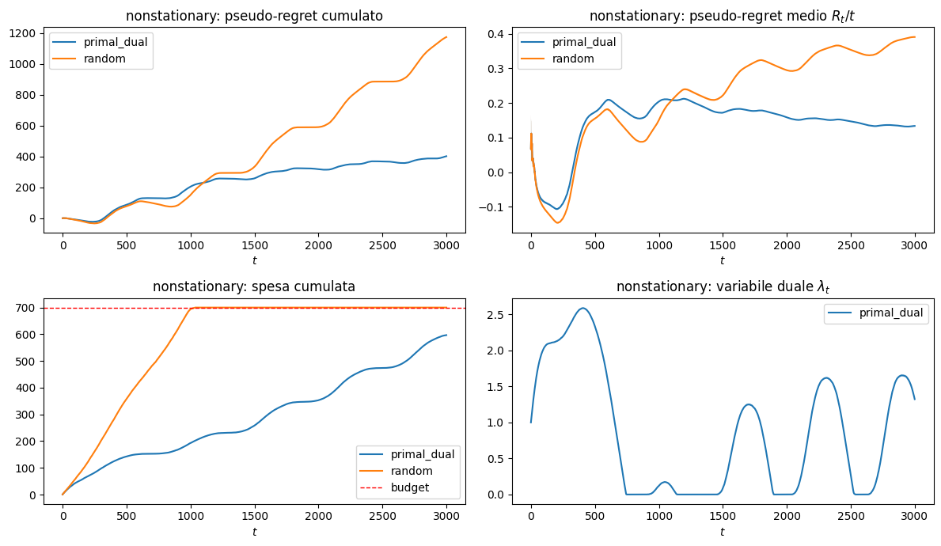
REQUIREMENT 3 · RESULTS
Results in Both Regimes
STOCHASTIC
HIGHLY NON-STATIONARY
0.249
→
0.121
0.222
→
0.134
569→676 · 558→597
regret/T, stochastic
regret/T, non-stationary
spend out of 700 — never a violation

Slide 17
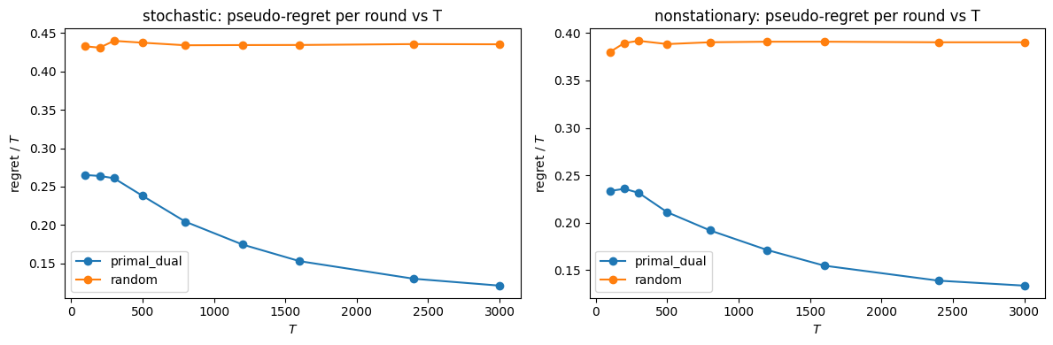
REQUIREMENT 3 · VALIDATION
Horizon Sweep: Best-of-Both-Worlds
0.27 → 0.12
0.23 → 0.13
regret/T as T grows, stochastic — consistent with sublinear regret
regret/T as T grows, non-stationary — same algorithm, same constants
Expected best-of-both-worlds behavior: sweeping from 100 to 3000, regret/round of primal-dual decreases in both regimes, while the random stays high and almost flat.

Slide 18
04
REQUIREMENT 4
Slightly Non-Stationary Environments with Multiple Campaigns
Combinatorial-UCB from Req 2, extended with a sliding window and a change detector , compared with the primal-dual method from Req 3. At each change point the competitor bid distributions change — and with them which campaigns are profitable.
HORIZON
BUDGET
ALGORITHMS
BENCHMARK
T = 3000
B = 560
SW Combinatorial-UCB CUSUM Combinatorial-UCB Primal-dual (full feedback)
≈ 1229
3 equal segments, L = 1000, 2 known change points (Υ _{T} = 2).
First-price auctions, 4 campaigns, ρ = B/T ≈ 0.187.
segment-local oracle: one LP per segment, same ρ per round.

Slide 19




REQUIREMENT 4 · SETUP
Environment
The cheapest campaign rotates at every change point:
T = 3000 · 3 segments · B = 560
One bid per campaign each round, from a grid of 8 values , denser on low bids (step 0.10, then 0.15).
SEGMENT 1
t = 1–1000
cheapest: C1
Conflict chain C1–C2–C3–C4: adjacent campaigns cannot both bid → 168 super-actions, 27 positive arms.
SEGMENT 2
t = 1001–2000
Each campaign has a hidden threshold , fixed within a segment, new at each change point.
cheapest: C2
Win where
, pay the bid (first price): utility
, cost
.
SEGMENT 3
t = 2001–3000
All campaigns draw from a shared budget B = 560, ρ = B/T ≈ 0.187 per round.
cheapest: C3
distributions of m_{i} · x: 0 to 1
C1
C2
C3
C4

Slide 20
REQUIREMENT 4 · LAB-ALIGNED
Methods
all hyperparameters from course formulas, Υ_{T} known
FORGETS BY CONSTRUCTION
DETECTS, THEN RESETS
NEVER FORGETS
SW-UCB
CUSUM-UCB
Primal-dual
discarded
window W
· Hedge on K = 168 super-actions, full feedback
· OGD on the dual λ (budget price)
· gains normalized in [0,1], per-action budget stop
· cache of the last W rounds only
· bonus computed with log W
· arm unseen in window: one forced pull
· M reference samples per arm → mean
· statistic accumulates deviations; over h → arm reset
· α-exploration keeps arms monitored
Both UCBs feed reward UCB + cost LCB into an LP over the super-action simplex, cap ρ = B/T fixed.
SHARED DECISION LAYER (REQ 2)

Slide 21
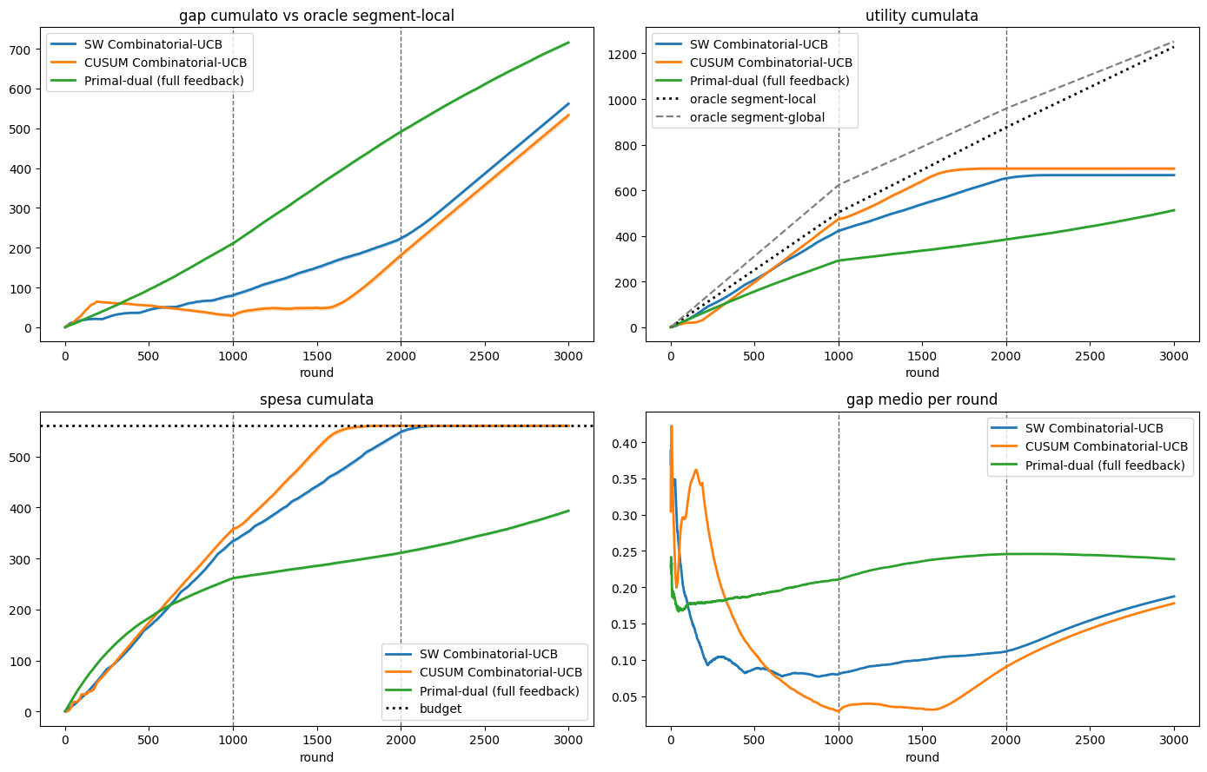
REQUIREMENT 4 · LAB-ALIGNED
Baseline, Course Formulas
30 trials · final gap vs segment-local oracle ≈ 1229
SW-UCB
562
CUSUM-UCB
533
Primal-dual
716
PROBLEMS TO FIX
① both UCBs spend all of B, but too early : cost LCB understates costs, fixed ρ never corrects
② primal-dual leaves 167 of 560 unused : infinite memory, conservative
③ CUSUM fires ~18 resets vs 54 reference : too few samples per arm to reach h ≈ 14.6 (no hand-tuning of h)
Mean over 30 trials, shaded SEM · dashed lines: change points · dotted: oracles and budget.

Slide 22



REQUIREMENT 4 · EXTENSION
Improved Version: Three Declared Changes
same environment, same benchmarks, same seeds
01 · WIDER WINDOW
02 · EMPIRICAL COST
03 · DYNAMIC PACING
· half a segment: widest window that stays comfortably stationary
· more samples per arm in the combinatorial setting
· derived from known quantities, not tuning
· replaces the cost LCB in the LP
· fixes the early budget exhaustion
· LP cap = remaining budget / remaining rounds
· recovers spend drift around change points
ablation, 30 trials each: gap 496 → 417 vs W = 219
supported by the Req 2 ablation: pseudo-regret 70 vs 166
same modification used in Req 2
CUSUM UNCHANGED — detector keeps the course formulas; only the decision layer changes (02, 03).
PRIMAL-DUAL UPGRADED — Req 3 theoretical rates, so each method enters the comparison in its best version.

Slide 23
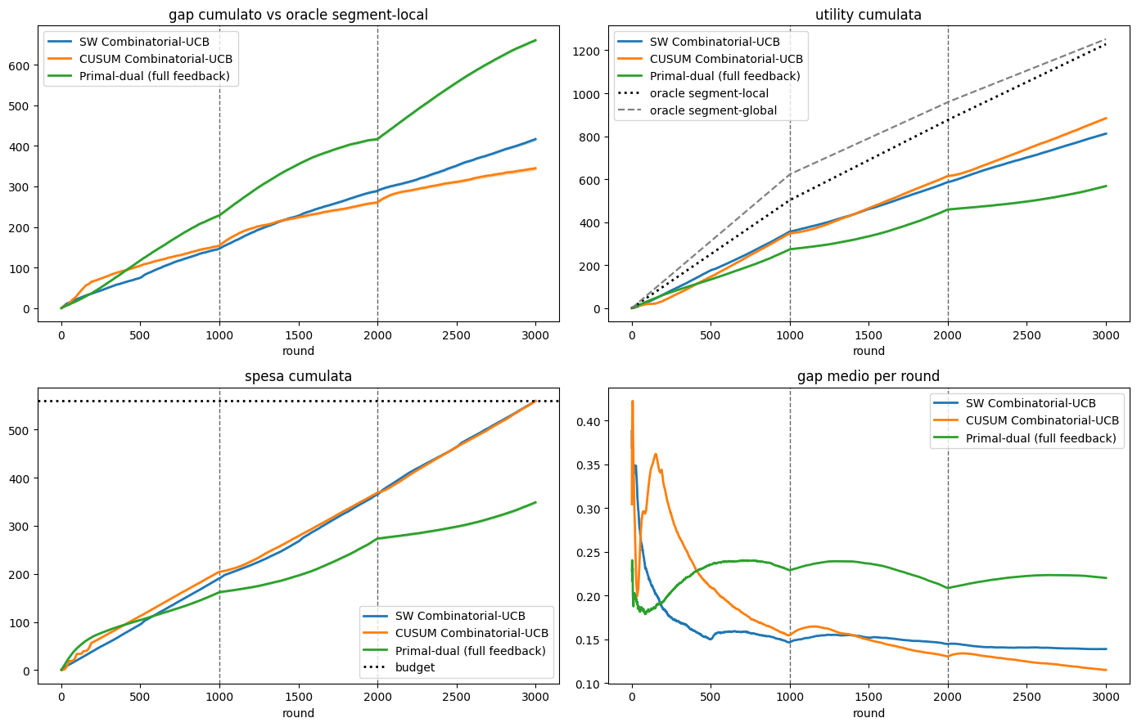
REQUIREMENT 4 · RESULTS
Results of the Improved Version
30 trials · same seeds · budget respected in every trial
FINAL GAP, BASELINE → IMPROVED
CUSUM-UCB
533 → 345
best method; resets concentrate near the true change points
SW-UCB
562 → 417
wider window, empirical cost, dynamic pacing
Primal-dual
716 → 660
theoretical rates; still leaves 211 of 560 unused
Light bar: baseline · solid bar: improved · scale up to 716.
Spend now reaches the horizon (pacing + empirical cost); the wider window fixes the sample side. CUSUM resets: ~18 → ~32 per trial.

Slide 24
REQUIREMENT 4 · COMPARISON
Comparison and Limits
average gap per round, improved versions
0.115
0.139
0.220
CUSUM-UCB , best: active resets refresh stats after each change
SW-UCB : passive forgetting pays a fixed variance price
Primal-dual: 0.239 with lab constants
TAKEAWAYS
LIMITS
· non-stationary UCBs clearly beat the primal-dual; CUSUM slightly ahead of SW
· CUSUM with course formulas stays weakly reactive with many arms
· primal-dual chases the best fixed distribution: wrong target on three segments
· theoretical rates move it only 716 → 660, and 211 of 560 stay unused: the limit is structural, not tuning
· the segment-global oracle (moves budget across segments) is out of reach for every online learner
· semi-windowed primal-dual tried and discarded: better than full, still below both UCBs, outside the course
· the gap does not vanish: repeated exploration after each change grows with the number of arms

Slide 25
ONLINE LEARNING APPLICATIONS
PROJECT PRESENTATION
Thank You
Arbizzani Tonelli Antonio · Arisi Leonardo · Berra Claudia · Di Paolo Gaia
July 2026

